Slide 1
STEP UP TO GCSE
PARENT INFORMATION EVENING
Wednesday 25th October 2023

Slide 2
LIFE AS A KS4 STUDENT
Preparations before the School Day
Good night’s sleep.
Wear the correct uniform.
Bring relevant books/files for lessons.
Bring correct equipment: black pen, purple pen, pencil, ruler, calculator, eraser, highlighter, protractor, compass.
Homework completed.

Slide 3
LIFE AS A KS4 STUDENT
Expectations During the School Day
Attend school regularly and punctually.
Complete work to the highest possible standard
Sustain effort and hard work throughout the courses.
Seek guidance when necessary.
Demonstrate behaviours in lessons to ensure all individuals can learn and staff can conduct lessons without disruption.

Slide 4
After the School Day
Each student will have regular homework set for each subject to include:
a) Reading around the information given in lessons.
b) Formal homework tasks such as worksheets.
c) Undertaking practice examination questions.
d) Revision for tests and assessments.
e) Redrafting previous work
f) Researching alternative points of view/interpretations.
LIFE AS A KS4 STUDENT
Homework

Slide 5
How attendance figures can be affected by absences
100% = Full attendance 90% = 18 Days
85% = 27 Days absence 75% = 45 Days absence
Impact upon lessons missed through non-attendance
1 day absent = 5 lessons missed
1 week absent = 25 lessons missed
2 weeks absent = 50 lessons missed
If a student had an 80% attendance figures between years 7-11 it would be
equivalent to missing one whole school year !

Slide 6
What is our Goal?
During KS4 nearly all learners will study the following:
GCSE Maths and Numeracy
GCSE English Literature and Language
Either GCSE Triple Science (Biology, Chemistry, Physics) or Double Award Science or Double Award Applied Science.
GCSE Welsh
RE – Agored Cymru
Skills Challenge Certificate (more in a bit)
PSE – Agored Cymru
3 option subjects
This equates to 14 GCSEs or equivalents

Slide 7
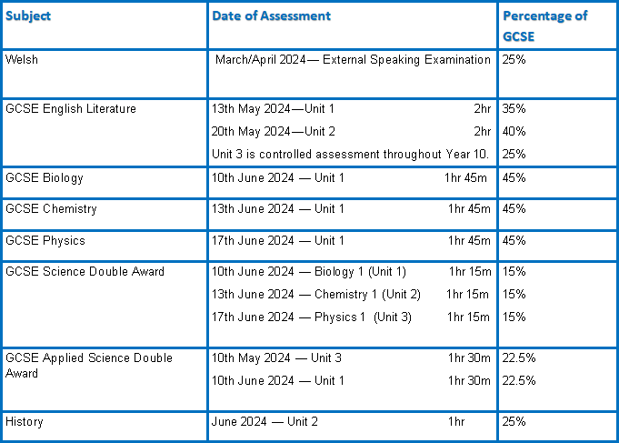
Assessment Timeline—Year 10

Slide 8
Assessment Timeline—Year 10
Some college courses will have examinations in May/June of Year 10.
English Literature will be taken in Year 10:
There are two June examinations Unit 1 and Unit 2 and controlled assessment.
The controlled assessment will take place throughout year 10.

Slide 9
Assessment Timeline – Year 10
Controlled Assessment
Very important in some subject areas, can be heavily impacted by poor attendance.
Most of the English Literature Coursework is being completed at the start of Year 10.
ICT, Product Design, Media Studies, History, Geography and Computer Science have significant controlled assessment components. Science has a practical examination.
PSE, Learning in the Outdoors and Skills Challenge are 100% controlled assessment

Slide 10
Mock / End of Year Examinations
Assessment Timeline—Year 10
Mocks for Science, English and History in March
End of year examinations after GCSEs finish in June.
Very important as this will help determine what tier students are entered for and what interventions need to take place in year 11.

Slide 11
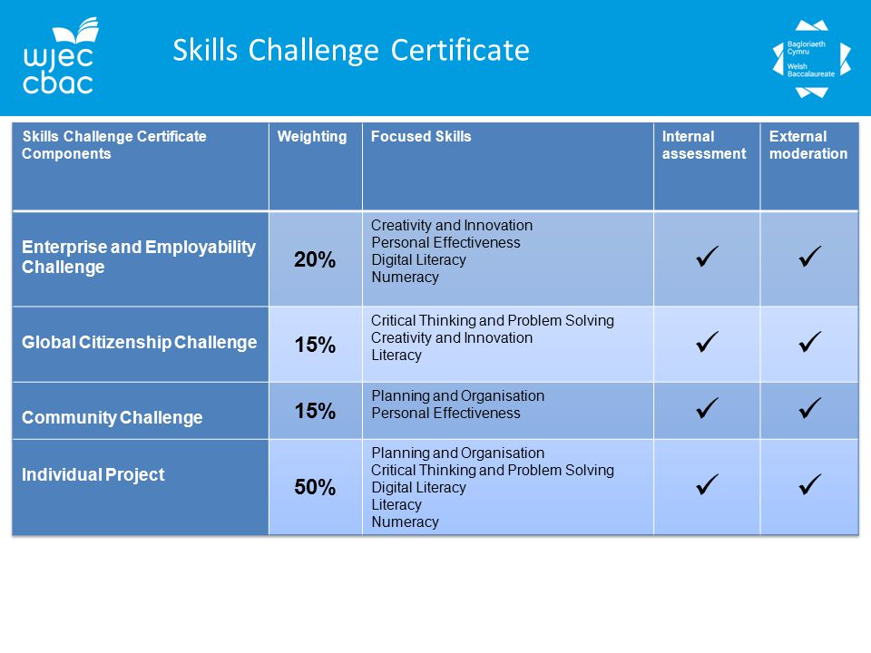

Slide 12
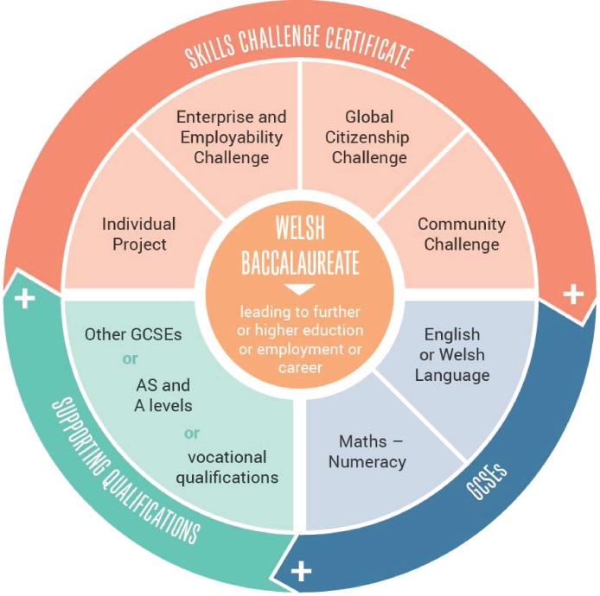

Slide 13
Assessment Timeline—Year 11
Most subjects will be examined at the end of year 11 only.
Mocks take place end of November/start of December
College courses may still enter students for exams in January.
Individual examination timetables will be provided by the examinations officer for all mocks and all external exams .

Slide 14
School Based Support
There are a number of ways we support our students in school:
Pastoral Support – this is co-ordinated by Mrs Williams, supported by Mr Griffiths. It includes access to counselling, learning coaches and info shop drop-ins for example.
Academic Support – we have an ‘open door’ policy where students can seek help at break-times, intervention on PG days, revision days, resilience exams, after school sessions and mentoring.
Nicky Preston (me!) Assistant Headteacher, oversees all exams and pastoral care.

Slide 16
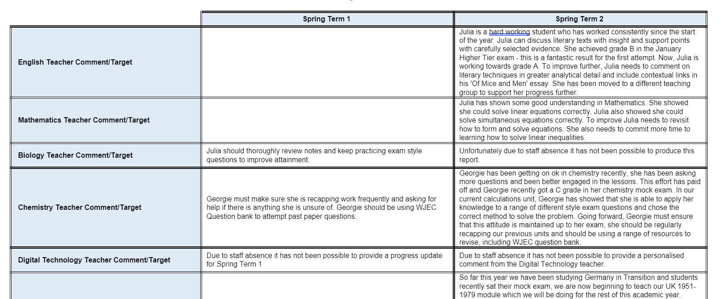

Slide 17
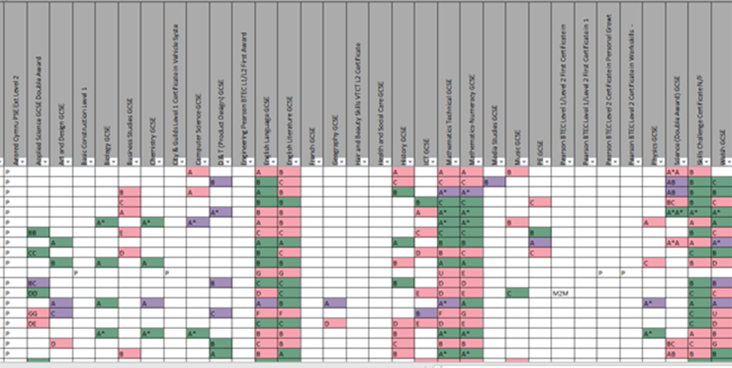

Slide 18
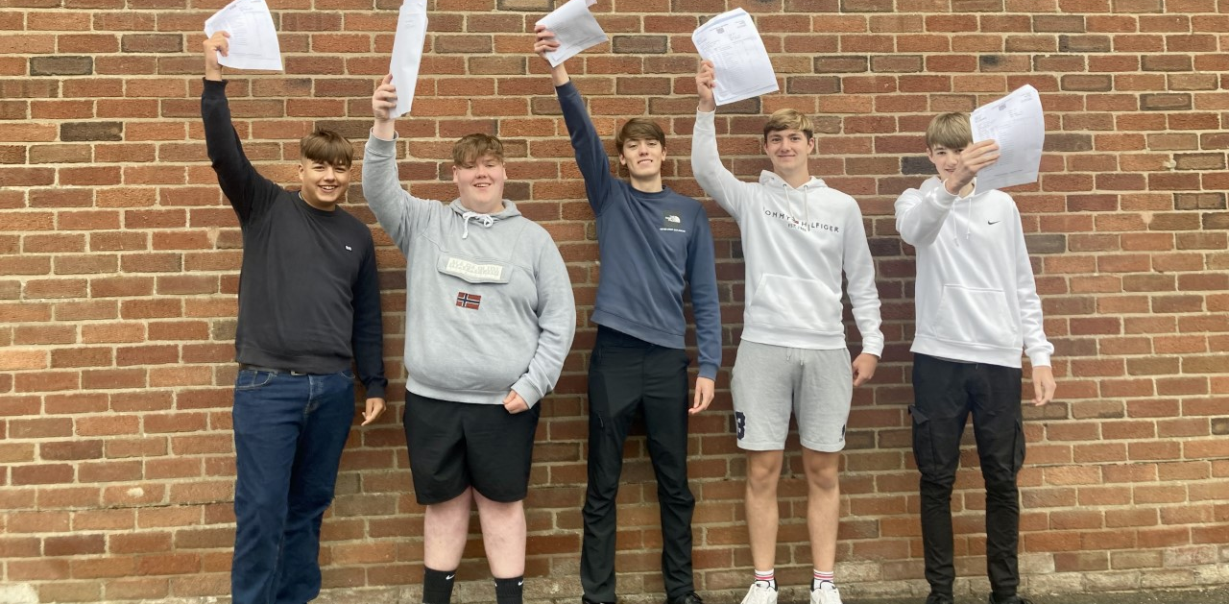
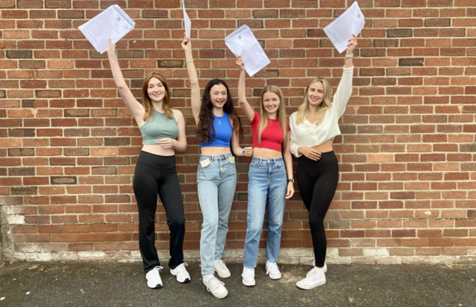
STEPS TO SUCCESS

Slide 19
What is My Role as a Parent/Carer?
Success in exams is a team effort which involves you, the school and your child working together to achieve.
Be prepared to play a number of roles!
Make home life as calm and supportive as possible.
Even though you might not feel like an expert, your support and input can still make a huge difference.
Become a good listener!
Be a positive source of encouragement.

Slide 20
Parents can help with……….
Motivation
Revision – planning and performance
The reluctant learner
Exam stress

