Slide 1
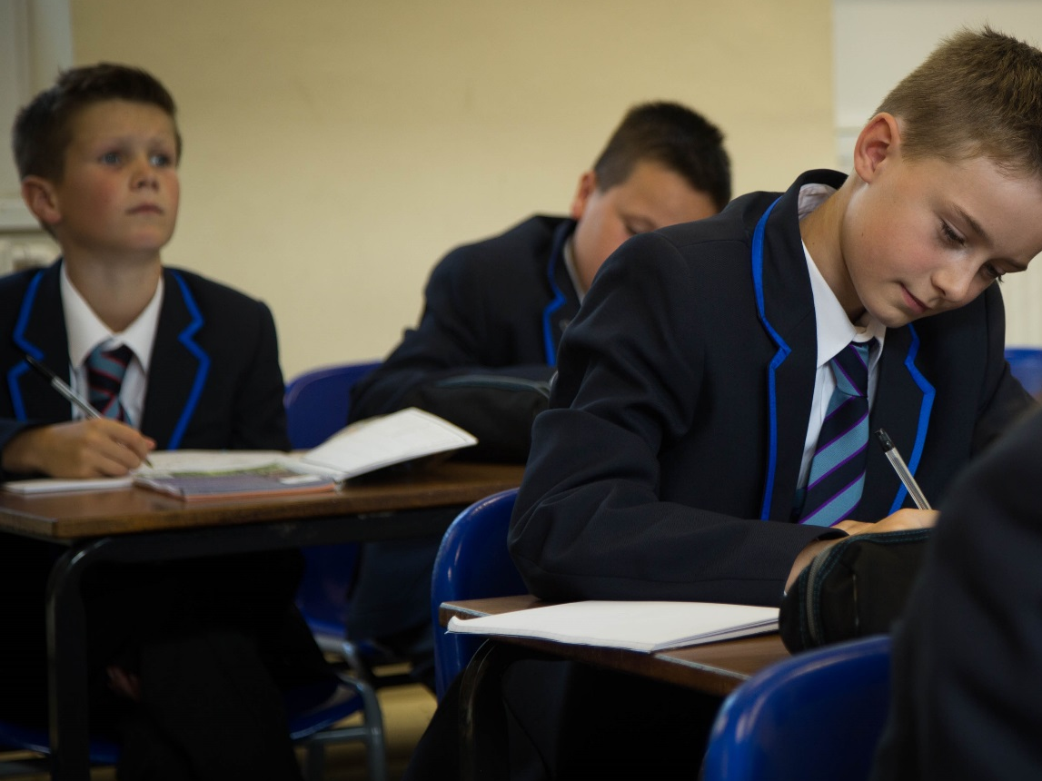
The Maelor School
Options Evening 2023

Slide 2
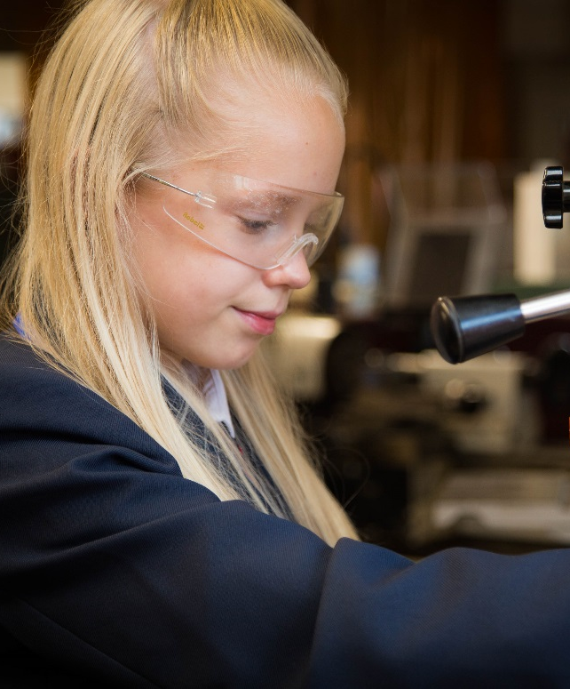
This Presentation
Discuss the rationale for the options available.
Provide timeline
Explain the process

Slide 3
Timeline
Stage 1
Students completed an options survey in December
Stage 2
This was analysed and used to put the options columns together.
Stage 3
Stage 4
Stage 5
Options form submitted to school.
Stage 6
Mrs Preston completes college applications for link courses.
Stage 7
Final confirmation letters sent to all students and parents.
Information evening to explain the options process.
Year 9 Parents’ Evening to discuss progress in subject areas.

Slide 4
Changes to the Welsh Curriculum from 2017
New GCSEs in English
Two Maths qualification
Skills challenge certificate
Welsh Full Course
Almost all GCSE’s content changed
Grades not numbers

Slide 5
Everyone
Maths x2
English x2
Science x2 or 3
Welsh x1
Skills Challenge Certificate x1 (in Science time)
PSE (Agored Cymru) equivalent to 2 Grade B at GCSE
RS
REALITY IS, ONLY CHOOSING THREE SUBJECTS

Slide 6
What Are the Option Subjects?
All of the courses available are explained in the options booklet.
Many of the subjects available are the traditional GCSE subjects such as History and Geography.
Some subjects are facilitating subjects, they are highly academic and if you are considering applying to Russel Group Universities in the future then at least one of these is advised.
Further advice on this is on the informed choices website.

Slide 7
Informed Choices
Now a web-based resource:
Informed Choices Link
Surprises:
Law – GCSE and A level History, NOT Law.
Engineering - GCSE and A level Maths and Physics.

Slide 8
What we have been told.
Not to specialise too early.
Keep options open
Balance of subjects at GCSE
Specialise at A Level.

Slide 9
Skills Challenge Certificate

Slide 10
Science
Many across the country do Dual award Science,(Science or Applied Science)
Biology, Chemistry and Physics all included
2 GCSEs
1 class of Separate Sciences, extra but not harder. They gain 3 GCSEs
Is not required for A levels just different topics, does provide a better grounding.

Slide 11
Computer Science
For the most able – very difficult Maths
Restricted to one class
Strong results – Better than CC
Don’t choose this and ICT, not varied enough.

Slide 12
Agored Cymru
Level 2 Vocational Courses (GCSE equivalent.)
Already offering the PSE program on PG Days.
Exciting opportunity to engage in some very different types of learning.
Two new courses offered:
Learning in the Outdoors
Work Related Education
Notes:
Work Related Education

Slide 13
Learning in the Oudoors
Learning in the Outdoors – this course is all about health and safety in the outdoor environment, sustainability, practical outdoor skills, expeditions and developing a greater understanding of the natural resources of Wales.
100% coursework/Practical work
Gains 1 or 2 GCSE equivalents at a grade B depending on how many units completed.
Recognised by colleges for entry requirements.

Slide 14
Work Related Education
Work Related Education – this course is all about exploring potential different careers and the skills and attributes required in the workplace including how to complete the job application process, and will include some work experience in a field of interest to the learner.
100% coursework/Practical work
Gains 1 or 2 GCSE equivalents at a grade B depending on how many units completed.
Recognised by colleges for entry requirements.

Slide 15
College Courses
Run on Wednesday afternoons.
Bus collects from school at 12.45 pm and drops at correct college site.
Courses run until 4.15 p.m.
Parents need to arrange own transport home.
Can only choose 1.
Big commitment, no changes allowed after the 3rd week of term.
Spanish also offered as a twilight. Day not yet confirmed. 4.30-6.30 after school. Parents to drop off and collect.

Slide 16
College Courses
 | Name of Course | Location
Level 1/2 | Sport and Coaching | Grove Park Site
Level 2 | Business Studies | Grove Park Site
Level 2 | Performing Arts | Grove Park Site
Level 2 | Engineering | Bersham Road
Level 2 | Construction | Bersham Road
Level 1 | Engineering | Bersham Road
Level 1 | Basic Construction Skills | Bersham Road
Level 2 | Public Services | Grove Park Site
Level 2 | Catering | Grove Park Site
Level 2 | Hairdressing and Beauty Therapy | Grove Park Site
GCSE | Health and Social Care | Grove Park Site
GCSE | Computer Science | Grove Park Site

Slide 17
It is important to be sure that a college course is the right option for you. There are open days you can attend at the college on the following dates:
17th January 2023, 5.00 - 7.00pm at Coleg Cambria, Yale, LL12 7AB (All courses except Engineering and Construction)
18th January 2023, 5.00 - 7.00pm at Coleg Cambria, Bersham Road, LL13 7UH (Engineering and Construction courses)
This link takes you to the appropriate area of the Colleg Cambria website.
14-19 Network College Links Information

Slide 18
How to Complete the options form
Please choose 1 option from each column A, B and C.
Please indicate your second choice in the box below.
If you are choosing to apply for college in option A, your second choice must be a school based course.
If you have any requests or clashes you want us to look at please write it in the box underneath.
Please can both parent and learner sign the options form.

Slide 21
Don’t Worry
If unsure or needing further advice:
Nicola.Holden@maelorschool.org.uk
Natalie.Williams@maelorschool.org.uk
Use the Link below to access Careers Wales :
Careers Wales Choosing Options Advice

